Slide 1

IE 6700 : Data Management for Analytics
Prof. Jin Xuemin
Online Food Review and Order Management System
Yizhe Wang
Mrudula Tanniru

Slide 2
Content
Introduction
Business Requirements
EER Diagram
UML Model
Relational Model

Slide 3
Introduction
The internet has fundamentally changed people's lives, including the way they order food.
Customers can now order various dishes or food online and wait for delivery anywhere.
Online platform services have made the food industry more efficient for both customers and restaurants.
Online customer reviews play an important role in customers' decision-making process for online ordering.
Our project aims to model an online food review and order management system for a platform company.
The system will leverage data analytics to provide a better user experience for both restaurants and customers.

Slide 4
Business Requirements
User Registration: Allow customers, owners, and delivery personnel to register an account to access the platform's features.
Order Placement: Allow customers to place orders online, including selecting dishes from a restaurant's menu, specifying delivery details, and making payment.
Order Management: Allow business owners to manage orders, including receiving, accepting, and preparing orders for delivery.
Order Tracking: Allow customers to track the status of their orders, including estimated delivery times and delivery updates.
Online Review System: Allow customers to leave online reviews of restaurants and their dishes, which can help other users make informed decisions when placing orders.
Business Rating System: Generate a rating system for each restaurant, based on the quality of their dishes, delivery times, and overall customer service.
Delivery Management: Allow delivery personnel to manage their delivery tasks, including accepting, picking up, and delivering orders.
Data Analytics: Collect data on user behavior, including ordering habits, popular dishes, and user feedback, to improve the platform's features and user experience.
Customer Support: Provide customer support to users, including help with order placement, technical issues, and other inquiries.
Security: Ensure the security of user data and payment information, including encryption of sensitive data and compliance with relevant regulations.

Slide 5
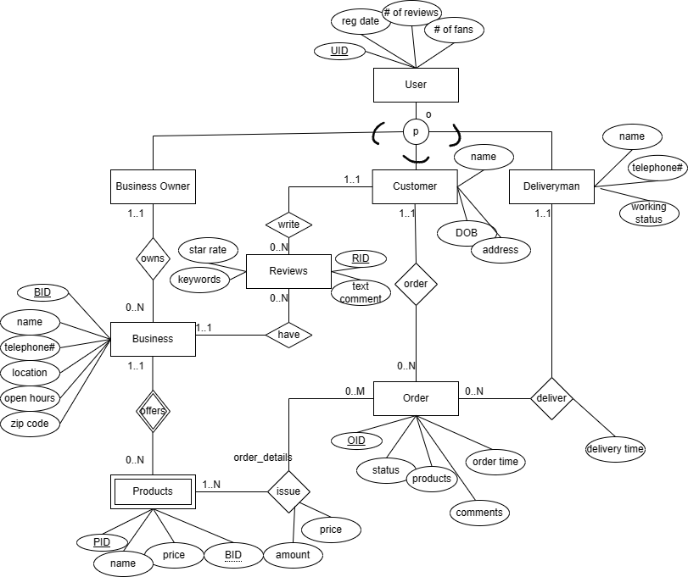
Entity Relational Diagram

Slide 6
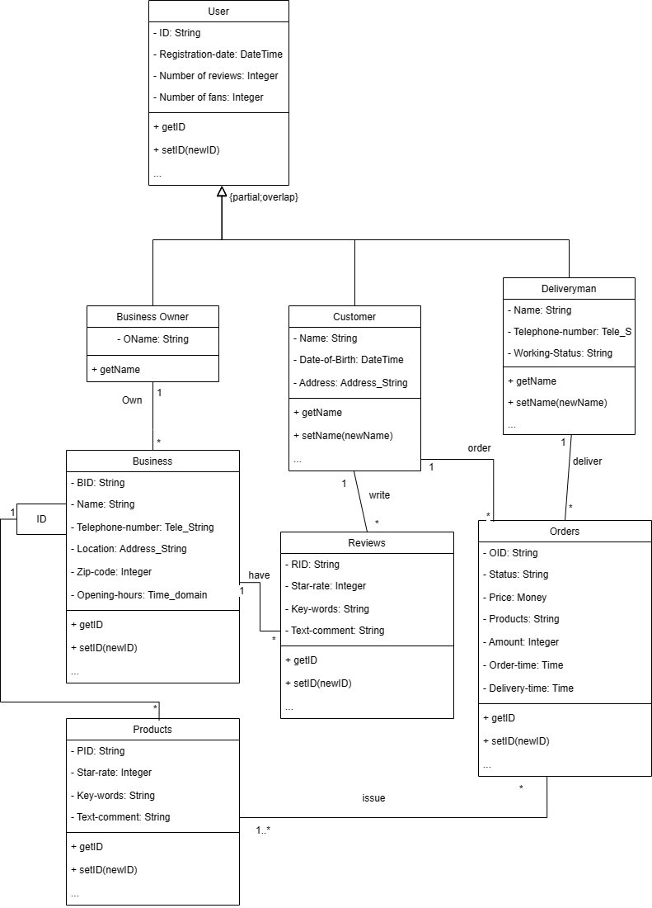
UML Model

Slide 7
Relational Model
USER(UID, registration date, number of reviews, number of fans)
BUSNIESS_OWNER(UID-BO, Oname)
- Foreign key UID-BO refers to UID in USER, NOT NULL
COSTUMER(UID-C, Cname, DOB, address)
- Foreign key UID-C refers to UID in USER, NOT NULL
DELIVERYMAN(UID-D, Dname, telephone number, working status)
- Foreign key UID-D refers to UID in USER, NOT NULL
BUSINESS(BID, Bname, telephone number, location, open hours, zipcode, UID-B)
-Foreign key UID-B refers to UID-BO in BUSINESS_OWNER, NOT NULL

Slide 8
PRODUCT_LIST(PID, BID-P, Pname, price)
- Foreign key BID-P refers to BID in BUSINESS, NOT NULL
REVIEWS(RID, star rating, keywords, text comments, BID-R, UID-R)
- Foreign key BID-R refers to BID in BUSINESS, NOT NULL
- Foreign key UID_R refers to UID in USER, NOT NULL
ORDER(OID, status, ordering-time, UID-C, BID-O)
- Foreign key UID-C refers to UID-C in CUSTOMER, NOT NULL
- Foreign key BID-O refers to BID in BUSINESS, NOT NULL
DELIVERY(delivery time, UID-D , OID-D)
- Foreign key UID-D refers to UID in USER, NOT NULL
- Foreign key OID-D refers to OID in ORDER, NOT NULL
ORDERDETAILS(OID-OD, PID-OD, price, amount)
- Foreign key PID-OD refers to PID in PRODUCT_LIST, NOT NULL
- Foreign key OID-OD refers to OID in ORDER, NOT NULL

Slide 9

THANK YOU

